Slide 1


DESIGN 1
Lesson 4: Formative: Finishing and Checking the F1 Website
Ms. Abboud • Grade 9 - Design 1 • Term 1, Week 5

Slide 2
Learning Objectives
WALT - We Are Learning To
WILF - What I'm Looking For
Finish the F1 website started in Lesson 3.
Check it against the formative checklist.
I create working hyperlinks.
I link webpages successfully.
I navigate efficiently between pages.

Slide 3
Frayer Model: Hyperlink (Review)
DEFINITION
CHARACTERISTICS
Clickable text or an image that takes the user to another webpage or location when clicked.
Clickable; takes the user somewhere else; created with <a>.
HYPERLINK
EXAMPLES
NON-EXAMPLES
A "Home" link in a navigation menu.
Plain unclickable text; an image with no <a> wrapper.

Slide 4
National Identity Integration
UAE Government Digital Services: government portals must link every service reliably, because a broken link can stop a resident from reaching the help they need. Today you prove every link on your site works.

Slide 5
STARTER
Spot the Bug
<a href="about">About Us</a>
<a href="Vision.html">Vision</a> (the file is vision.html)
<a href=index.html>Home</a>
Hook • Engage & Ask
5 - 10 minutes

Slide 6
LESSON CORE
I Do: The Final Checklist
Part of the Hyperlinks, Images & Tables formative (10 pts). Today: Working hyperlinks & navigation (4 pts).
Today you finish your website from Lesson 3, then go through every check on the Final Checklist.
Gradual Release of Responsibility
30 - 40 minutes
1 / 3

Slide 7
LESSON CORE
We Do: What a Correct Menu Looks Like
The same menu sits at the top of every page, right after <body>.
Stuck? Ask for the Example Code sheet and compare one line at a time.
Gradual Release of Responsibility
30 - 40 minutes
Example: a correct menu (identical on all 4 pages)
<nav>
<ul>
<li><a href="index.html">Home</a></li>
<li><a href="about.html">About Us</a></li>
<li><a href="contact.html">Contact Us</a></li>
<li><a href="vision.html">Vision and Mission</a></li>
</ul>
</nav>
2 / 3

Slide 8
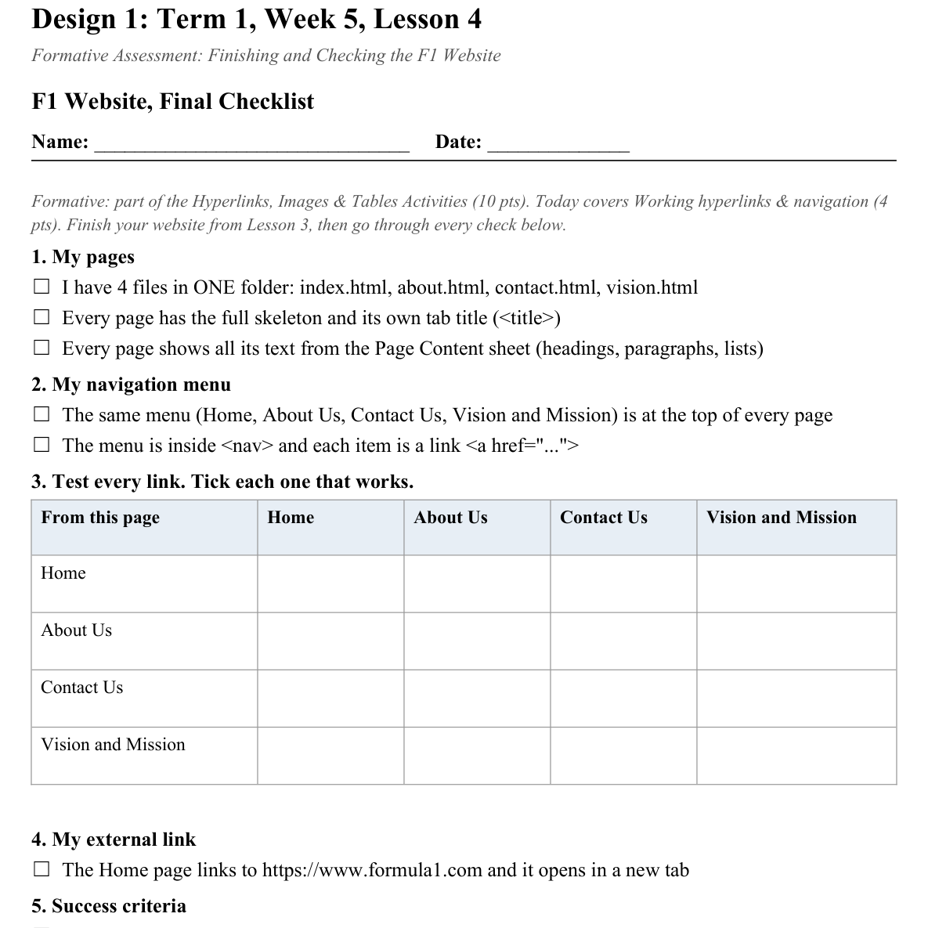
LESSON CORE
You Do: Finish, Check, Swap
Finish your pages and tick every item on the Final Checklist.
Swap with a partner, try to break their navigation, then submit via Toddle.
Activity: F1 Website, Final Checklist
Gradual Release of Responsibility
30 - 40 minutes
3 / 3

Slide 9
CLOSURE
Exit Ticket
One navigation design choice from a real website you want to copy for your own site.
Transition & Extend
5 - 10 minutes

